Slide 1
CDK2AAB4 STRUKTUR DATA
Doubly Linked List
Variations of Linked List

Slide 2
Doubly Linked List
Linked list with 2 pointers
Connect previous and next element
first
last
/ | 12
 | 35
 | 78 | /
CDK2AAB4 – STRUKTUR DATA

Slide 3
Structure
Usually with 2 head pointer
Each element divided into 3 parts
first
last
/
 |  | /
prev
info
next
CDK2AAB4 – STRUKTUR DATA

Slide 4

ADT Element Doubly Linked List
type Infotype : integer
type Address : pointer to ElmList
type ElmList <
info : Infotype
next : Address
prev : Address
>
prev
info
next
There are 2 pointers to point the next and previous element
CDK2AAB4 – STRUKTUR DATA

Slide 5
ADT Doubly Linked List
type List : <
first : Address
last : Address
>
Dictionary
L : List
first
last
List
There are 2 heads to point the first and the last element on the list
CDK2AAB4 – STRUKTUR DATA

Slide 6
Reuse the ADT
Try to feel the benefit of ADT
If you have already defined ADT for Singly Linked List, modify it a little to have an ADT for Doubly Linked List
Any modification only in specifying function (implementation)
CDK2AAB4 – STRUKTUR DATA

Slide 7
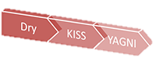
Remember DRY Principles
“When you find yourself writing code that is similar or equal to something you've written before,
“take a moment to think about what you're doing and don't repeat yourself.”
CDK2AAB4 – STRUKTUR DATA

Slide 8
Create New List
Algorithm
L.first = NIL
L.last = NIL
first last
/
/
L
X.last is a keyword to refer the last element of the list X
On the creation of new list, there is no element, thus L.first and L.last is NIL
CDK2AAB4 – STRUKTUR DATA

Slide 9
Creating New Element
P
Algorithm
allocate(P)
P→next = NIL
P→prev = NIL
P→info = 10
prev info next
/
10
/
Y→prev is a keyword to refer the previous element of element pointed by Y
On the creation of new element, set next and prev element = NIL
CDK2AAB4 – STRUKTUR DATA

Slide 10
Keywords
X.first
Y→next
Y→info
X→last
Select the last element of list X
X→prev
Select the previous element of element Y
CDK2AAB4 – STRUKTUR DATA

Slide 11
Exercise
first
last
L
P
/ | 12
 | 43
 | 68
 | 80
 | 89 | /
Task: Draw the Pointer
Q = ( P→prev )→prev
R = ((( L.last )→prev )→prev )→next
S = ((( P→next )→prev )→next )→next
CDK2AAB4 – STRUKTUR DATA

Slide 12
Exercise
first
last
L
P
/ | 12
 | 43
 | 68
 | 80
 | 89 | /
Task : How to … | output | Answer
Access info of the last element | 89
Access info of the second element of the list | 43
Access info of the fourth element of the list | 80
Copy info of 4th element to 2nd element
Make P points 4th element
CDK2AAB4 – STRUKTUR DATA

Slide 13
Exercise
first
last
L
P
/ | 12
 | 43
 | 68
 | 80
 | 89 | /
Task : what is the output? | Answer
(((( L.last )→prev )→next )→prev )→info
(( P→next )→next )→info
((( P→next )→prev )→prev )→info
((((( L.first )→next )→prev )→next )→next )→info
CDK2AAB4 – STRUKTUR DATA

Slide 14
Exercise
first
last
L
P
/ | 12
 | 43
 | 68
 | 80
 | 89 | /
Task : what is the output? | Answer
( P→next )→info + ( L.last→prev )→info
( L.first )→info – (( P→next )→next )→info
( P→prev )→info – ((( L.first )→next )→next )→info
((((( L.first )→next )→prev )→next )→next )→info + P→info
CDK2AAB4 – STRUKTUR DATA

Slide 15
Question?

Slide 16
Inserting new Element
Insert first
Insert last
Insert after
CDK2AAB4 – STRUKTUR DATA

Slide 17
Insert First
WHAT WILL HAPPEN IF THE LIST IS EMPTY?
Algorithm
P→next = L.first
( L.first )→prev = P
L.first = P
P
/ | 6
/
 | 12
 | 68
 | 89 | /
/
L
first
last
CDK2AAB4 – STRUKTUR DATA

Slide 18
Insert First on empty list
Algorithm
P→next = L.first
(L.first )→prev = P
L.first = P
// if list is empty
L.first = P
L.last = P
P
ERROR
/ | 43 | /
/
/
first
last
L
CDK2AAB4 – STRUKTUR DATA

Slide 19
Insert First
Algorithm
if L.first != NIL and L.last != NIL then
P.next = L.first
(L.first )→prev = P
L.first = P
else { List is empty }
L.first = P
L.last = P
endif
CDK2AAB4 – STRUKTUR DATA

Slide 20
Insert Last
Algorithm
P→prev = L.last
( L.last )→next = P
L.last = P
Again, careful when the list is empty
P
/
 | 99 | /
/ | 12
 | 68
/
 | 89
L
first
last
CDK2AAB4 – STRUKTUR DATA

Slide 21
Insert After
Algorithm
P→next = pred→next
P→prev = pred
( pred→next )→prev = P
pred→next = P
P
pred
 | 77
/
/
/ | 12
 | 68
 | 89 | /
L
first
last
CDK2AAB4 – STRUKTUR DATA

Slide 22
Deleting the Element
Delete first
Delete last
Delete after
CDK2AAB4 – STRUKTUR DATA

Slide 23
Delete First
Algorithm
P = L.first
L.First = P→next
P→next = NIL
( L.first )→prev= NIL
return P
WHAT WILL HAPPEN IF THERE IS ONLY 1 ELEMENT INSIDE THE LIST ?
first
last
L
/
/
 | 80
 | 89 | /
/ | 12
 | 43
P
CDK2AAB4 – STRUKTUR DATA

Slide 24
Delete First
Algorithm
P = L.first
L.first = P→next
P→next = NIL
( L.first→prev = NIL )
//if only one element
L.first = NIL
L.last = NIL
return P
P
ERROR
/ | 12 | /
first
last
L
CDK2AAB4 – STRUKTUR DATA

Slide 25
Delete First
Algorithm
P = L.first
if L.first != L.last then
L.first = P→next
P→next(P) = NIL
prev(first(L)) ← Nil
else
L.first = NIL
L.last = NIL
endif
return P
CDK2AAB4 – STRUKTUR DATA

Slide 26
Delete Last
Algorithm
P = L.last
L.last = L.last→prev
P→prev = NIL
( L.Last )→next = NIL
return P
first
last
L
/
/
/ | 12
 | 43
 | 89 | /
P
CDK2AAB4 – STRUKTUR DATA

Slide 27
Delete After
Algorithm
P = pred→next
Pred→next = P→next
P→next→prev = pred
P→prev= NIL
P→next = NIL
return P
pred
P
/
/
/ | 12
 | 43
 | 80
 | 89 | /
L
first
last
CDK2AAB4 – STRUKTUR DATA

Slide 28
Question?

Slide 29
Home Task
Modify your previous task (Singly Linked List) into Doubly Linked List
Write each procedure of insert and delete
Write a function/procedure to search an element by id and output the info of the element
Note : job description should be different from the previous task
CDK2AAB4 – STRUKTUR DATA

Slide 31
DLL Primitives
Create new list
Create new element
Insert first
Insert last
Insert after
Delete first
Delete last
Delete after
Pay attention to:
empty list,
list with only 1 element

Slide 32
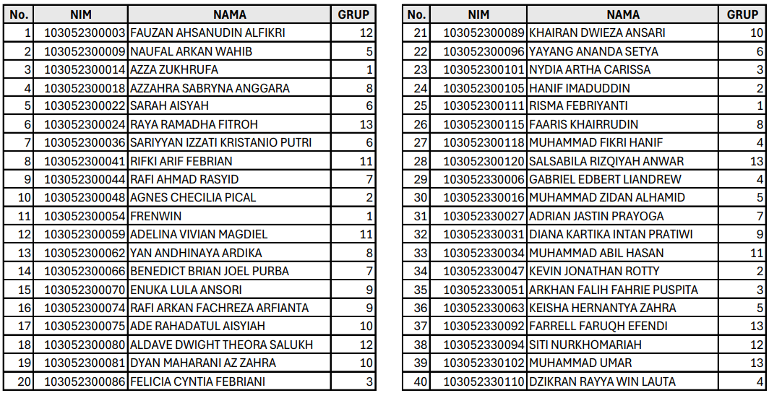
DS-47-03

